Slide 1
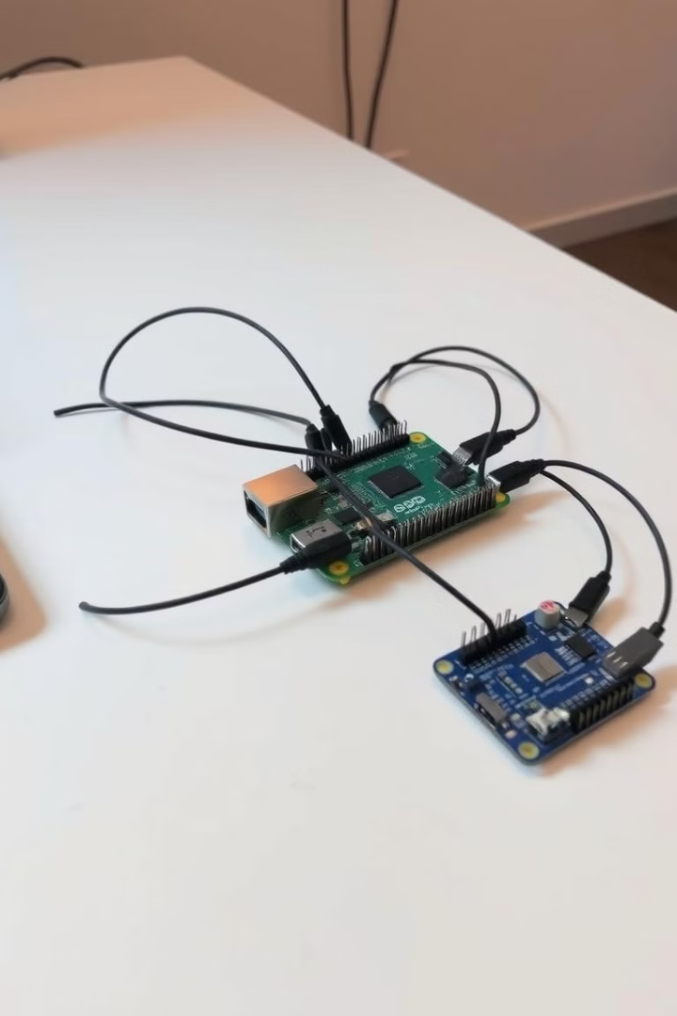

Project Documentation: IoT-Based Control System
This project presents an advanced IoT-based control system integrating multiple embedded devices, including Raspberry Pi Zero W, ESP32, and ESP8266, leveraging the MQTT protocol for seamless communication. The system is designed to process sensor data, execute motor control, and manage servo operations based on user input and real-time sensor readings.
by Ziad Mohammed Fathi

Slide 2
System Architecture
Raspberry Pi Zero W
ESP32
ESP8266
Bash Script
Functions as the central node, reading IR sensor data and publishing it to the MQTT broker.
Responsible for motor control, receiving commands via MQTT.
Manages servo motors based on IR sensor input and password validation through MQTT.
Provides a command-line interface for users to send control commands via MQTT.

Slide 3
Hardware Components
1
Raspberry Pi Zero W
2
ESP32
Reads IR sensor data and publishes messages to MQTT.
Controls two DC motors using an H-bridge motor driver.
3
ESP8266
4
IR Sensors
Operates servo motors via a PCA9685 PWM driver.
Detect environmental changes and provide data to Raspberry Pi.
5
Servo Motors
6
DC Motors
Controlled by ESP8266 based on IR sensor data and password authentication.
Managed by ESP32 according to MQTT commands.

Slide 4
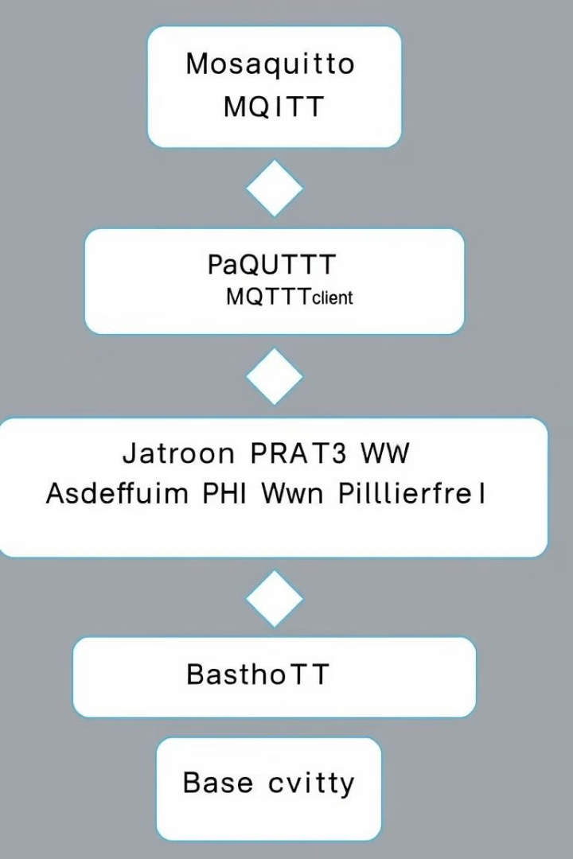
Software Components
Mosquitto MQTT Broker
Facilitates device communication.
Paho MQTT Client
Enables MQTT connectivity for Raspberry Pi and ESP devices.
Adafruit PWM Servo Driver Library
Controls servo motors via ESP8266.
Bash Script
Provides a CLI-based control interface.

Slide 5
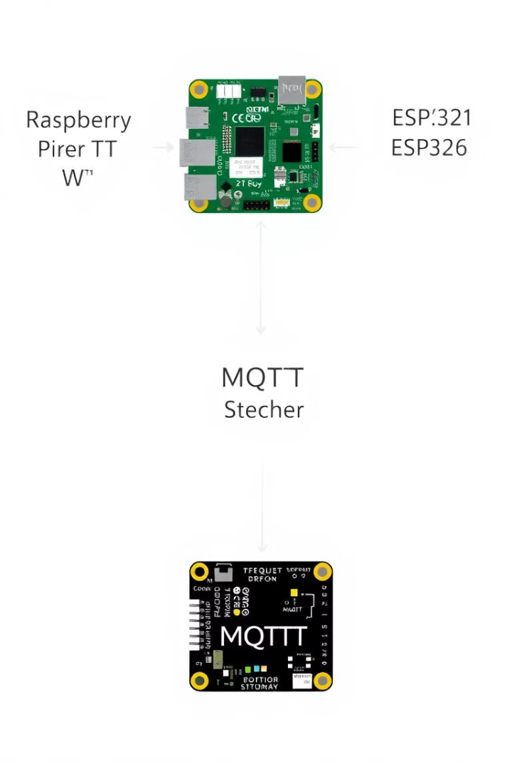




System Workflow
Raspberry Pi Zero W
ESP32
ESP8266
Reads IR sensor data from GPIO pins, publishes sensor data to the MQTT topic ir/sensors, and captures user password input and publishes it to password/topic.
Subscribes to MQTT topics motor1/control and motor2/control, and controls two DC motors based on received MQTT messages.
Subscribes to MQTT topics ir/sensors and password/topic, operates servo motors based on sensor input, and validates the password and adjusts servo positions accordingly.
Bash Script
Provides a CLI for motor control and sends MQTT commands to actuate motors.

Slide 6

Detailed Component Breakdown
Raspberry Pi Zero W
1
Reads IR sensor data via GPIO pins (2, 3, and 4), publishes data to MQTT broker using Paho MQTT, and captures user-inputted passwords and relays them through MQTT.
2
ESP32
Controls two DC motors through GPIO (pins 27, 26, 25, and 33), and communicates via MQTT to receive motor control commands.
ESP8266
3
Uses PCA9685 for PWM-based servo control, and processes password authentication for servo actuation.
4
Bash Script
CLI-based user interaction for motor control, and publishes MQTT messages for motor actuation.

Slide 7





MQTT Topic Structure
ir/sensors
Publishes IR sensor readings from Raspberry Pi.
password/topic
Publishes user-inputted passwords.
motor1/control
Controls DC Motor 1.
motor2/control
Controls DC Motor 2.

Slide 8
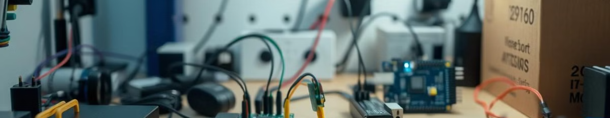
Conclusion
This project showcases a sophisticated IoT system integrating Raspberry Pi Zero W, ESP32, and ESP8266 using MQTT for efficient device communication. The system is designed to read sensor data, execute motor control, and manage servo actuations, ensuring reliable and scalable operation.

Slide 9
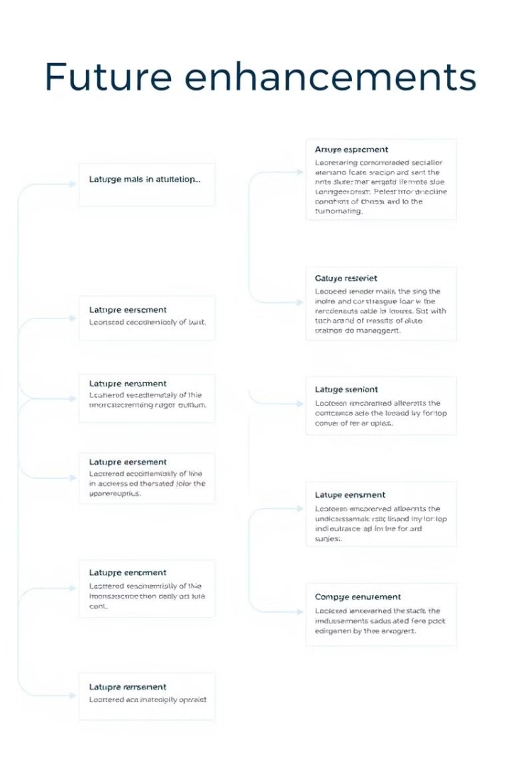
Future Enhancements
Security Improvements
Implement TLS/SSL encryption for secure MQTT communication.
User Interface
Develop a web-based or mobile application for enhanced user experience.
Data Logging & Analytics
Integrate database storage for sensor and control logs.
Cloud Integration
Extend functionality using AWS IoT or Google Cloud IoT.

Slide 10

Key Takeaways
This document serves as a comprehensive technical guide to the project, detailing its architecture, workflow, and potential future enhancements. The project demonstrates the power of IoT technology to create intelligent and interconnected systems, enabling seamless communication and control between embedded devices.

